Slide 1

Emma Doyle

Slide 2
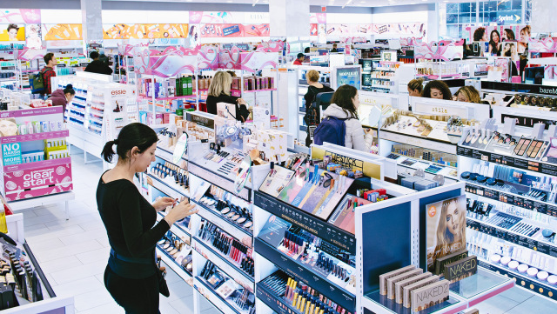
Who we are
Ulta is a cosmetic store that has both high-end and drug store products as well as beauty services such as hair cuts, full makeovers and eyebrow waxing stations.
The cosmetic industry is made up of skincare, hair care, make-up, perfumes, toiletries, deodorants and oral hygiene products. It is projected to be worth 90 Billion by 2020. Competitors: Sephora, Macy’s, Sally Beauty, CVS, Walgreens

Slide 3



SWOT ANALYSIS
Strengths: Reward program, affordability, cosmetic services, growing their stores, carries 500+ brands including unique brands such as Kylie Cosmetics, Morphe and Colour Pop.
Weaknesses: Busy, doesn't’t have some prestige brands such as Fenty, so it can be seen as less nice, and brand awareness in some areas.
Opportunities: mostly in suburban areas, could expand to malls, expand internationally since its only in the US, and more services.
Threats: Sephora, more prestigious retailers.

Slide 4
What we WANT
SMART goal: to increase our website leads by 30% via YouTube affiliations and discount codes by the end of May 2019.
This will give shoppers an incentive to pick ULTA over Sephora and other competitors.
The call to action is to use the discount code.
Goals

Slide 5
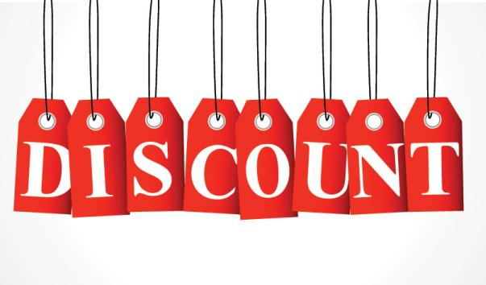
Who we’re talking to: Target Audience
Females aged 16-24 in the United States.
Reach them through the YouTubers they love online and in advertisements both on social media and print ads.
Their wants and needs are buying products at a discounted rate and being aware of these discounts on the platforms they already use.
Messaging they will respond to is discount codes and recommendations from trusted beauty influencers.

Slide 6
What’s our message: strategy
USP: The brands you love at the price you love
Channels:
  Instagram, Facebook, and Twitter Ads – to reach the correct audience
  Paper advertisements – reach those who may not be aware of YouTubers
  YouTube affiliate links – reaching those watch those who have influence in the beauty world

Slide 7

Editorial calendar
  Post a new YouTuber on social media each month for 6 months
    Post clips from the YouTuber on social media as stories, IGTV, etc., once every two weeks.
  Have the discount codes on fliers that are sent out almost weekly
  YouTubers will mention the affiliate codes when Ulta sponsors the videos or, if they choose, just have the affiliate benefits linked in the description box

Slide 8
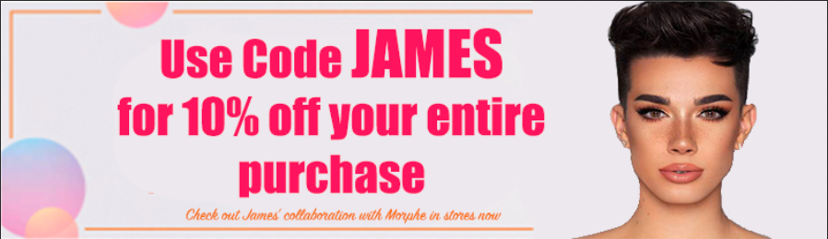
How we deliver: execution

Slide 9
Creative
For social media: posts by the ULTA announcing the new YouTuber each month with an ad and a video of the YouTuber on the stories introducing themselves and the codes.
For the print ads: the affiliate code would be in place of the $3.50 off coupons each week.
The 5.3 million followers on Instagram can be leveraged for awareness.
The team assembled will be the marketing team at ULTA as well as the YouTubers.

Slide 10
What we did
The way to measure the success of this campaign would be seeing how many times the discount code is used online. Even though the store will have the discount codes too, web transactions will be the focus to track with the affiliate links.
Post-campaign learning would be whether they feel continuing discount codes would be beneficial for the brand.
Results

